Slide 1
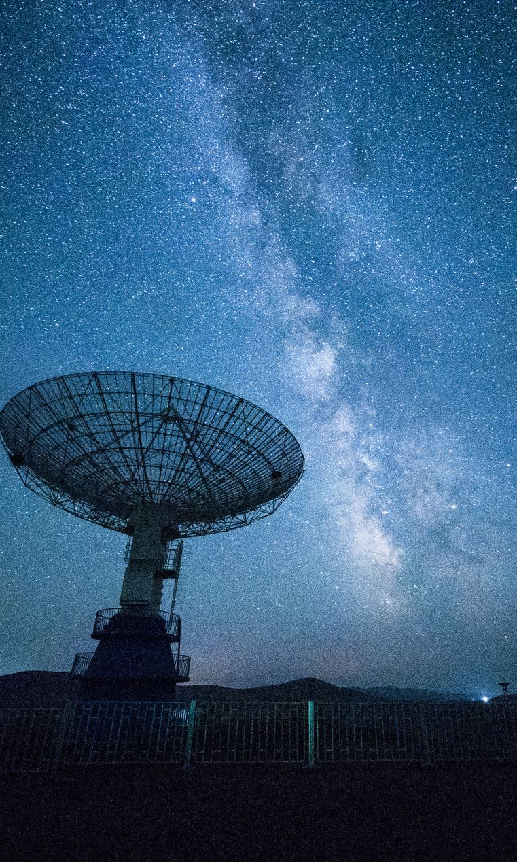
The Milky Way and its Millisecond Pulsar Population
Shiyang Zhang, Arend Moerman,
Erwan Hochart

Slide 2
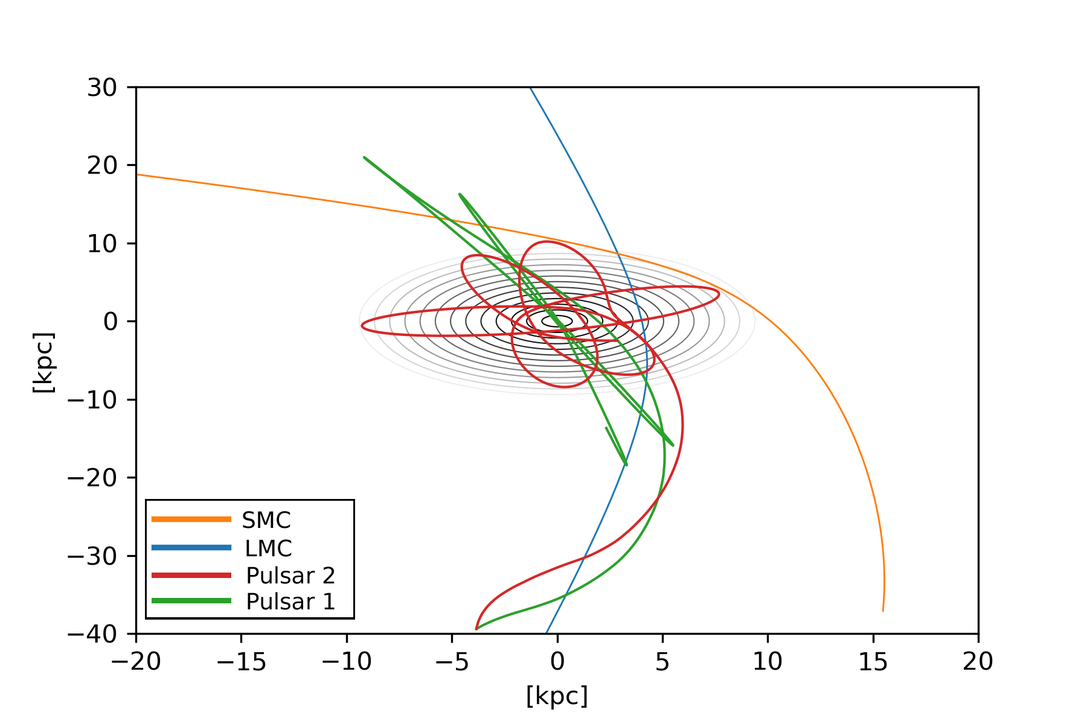
Overview
Millisecond Pulsars: What are they?
Sampled Millisecond Pulsar Population
Birth Rate
Velocity Distribution
Mass Distribution
The Code
Gravitational Potentials
The general methodology
The Results
Future Research

Slide 3
Overview
Millisecond Pulsars: What are they?
Sampled Millisecond Pulsar Population
Birth Rate
Velocity Distribution
Mass Distribution
The Code
Gravitational Potentials
The general methodology
The Results
Future Research

Slide 4
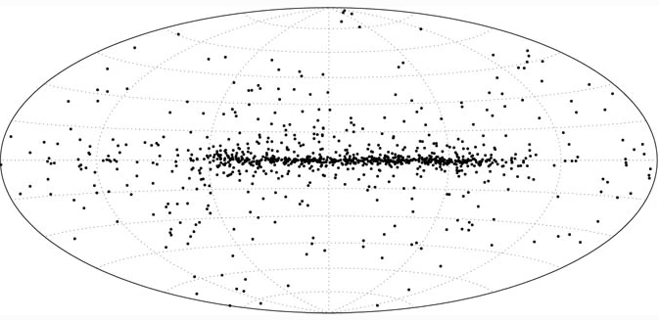
Millisecond Pulsars: What are they?
Supernova event causes significant mass loss
Millisecond pulsars rotate 30 to 700 times per second
Lifetime comparable to the age of the Universe
Research targets for a wide range of physics
General Relativity
Planetary Systems
Image courtesy of Lorimer 2001
1. Millisecond Pulsars: What are they?
Notes:
Neutron stars are dead stars formed after a Supernova explosion if their mass is at the Chandrasekhar limit. They gain their massive spin from the conservation of angular momentum where if they lose a significant portion of their mass and size, they need to make up for it with their rotational velocity.
If they rotate quick enough they will emit electromagnetic radiation since charged particles accelerate along their magnetic field lines and this emission can then be observed by us if it passes our line of sight
Millisecond pulsars are a class of pulsars that rotate extremely quick
To achieve their rotational speeds it has to accrete mass from another star making them commonly found in binary systems and so globular clusters, being the densest environment of a galaxy tend to be a nursery for such objects
If the binary star undergoes a supernova explosion the MSP may be ejected – there is still a mystery as to why there is such a large fraction of MSP that seem to be in solitary systems (~20%) and so we look at the possibility of captured pulsars from nearby systems such as the LMC and SMC
We use MSP due to them having a lifetime comparable to the age of the Universe therefore being able to migrate between galactic systems without us ever realizing it. Other classes of pulsars live only up to 100 Myr
This periodic observation of EM signal every time it crosses our line of sight has given for a wide range of possible research using pulsars in physics, from theory of general relativity to being used to detect the first extra-solar planetary system

Slide 5
Overview
Millisecond Pulsars: What are they?
Sampled Millisecond Pulsar Population
Birth Rate
Velocity Distribution
Mass Distribution
The Code
Gravitational Potentials
The general methodology
The Results
Future Research

Slide 6
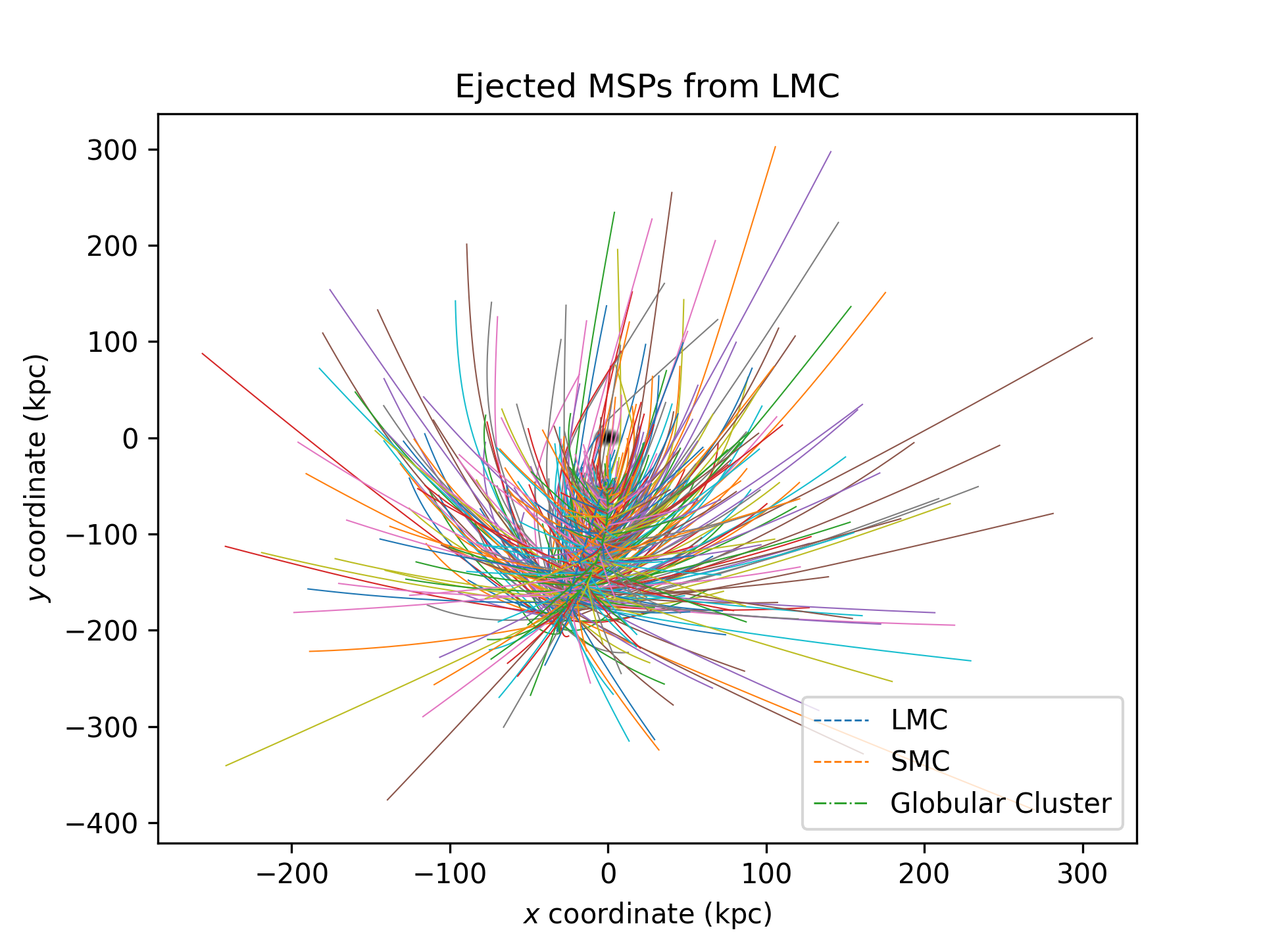
Sampled Millisecond Pulsar Population: Birth Rate
Milky Way birthrate: ~0.05 Myr
LMC birthrate: ~1.80 Myr
SFR of Milky Way and LMC
Incorporate fraction of binary population
Total of 555 ejections per simulation
2.1 Sampled Millisecond Pulsar Population: Birth Rate
Notes:
This was a major assumption in our report as there were no papers found analysing the birthrate of MSP in the LMC
We used the SFR of the MW and LMC of the last 2Gyr and used it as a ratio of their MSP birthrate based on the observed birthrate of the MW
Last 2Gyr because our simulation goes 1Gyr back in time
This gave an original result of a MSP being born every 0.36 Myr but if we incorporate the fact that 20% of them are solitary – which is the population we want as these systems have had a high enough velocity to be ejected from the system, our new birth rate becomes every 1.80 Myr

Slide 7

Sampled Millisecond Pulsar Population: Velocity Distribution
Only look at a Supernova origin
Distribution based on Hansen and Phinney (1997)
$$P\left(v_{k}\right)=\sqrt{\frac{2}{π}}\frac{{{\overline{v}}_{k}}^{2}}{σ_{v}^{3}}\exp\left[−\frac{v_{k}^{2}}{2σ_{v}^{2}}\right]$$
$σ_{v}=190 km s^{−1}$
${\overline{v}}_{k}=250 km s^{−1}$
Randomised orientation
2.2 Sampled Millisecond Pulsar Population: Velocity Distribution

Slide 8
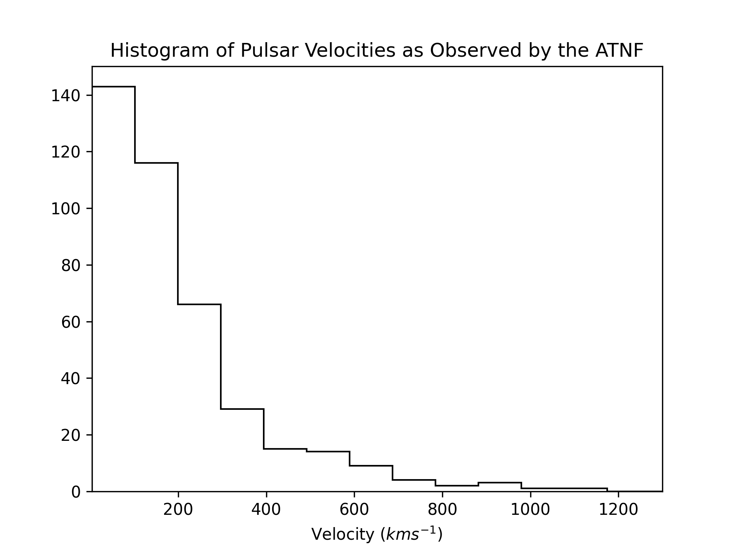
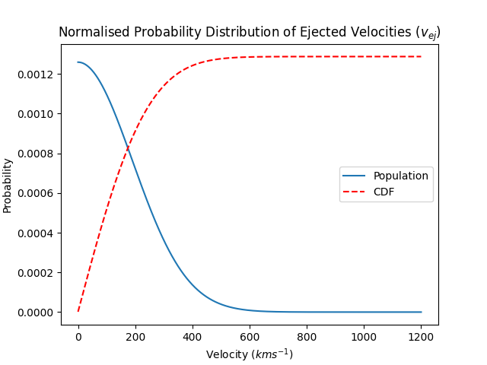
Sampled Millisecond Pulsar Population: Velocity Distribution
Data taken from the Australia Telescope National Facility catalogue (2019)
2.2 Sampled Millisecond Pulsar Population: Velocity Distribution

Slide 9

Sampled Millisecond Pulsar Population: Mass Distribution
Energy conservation code
Neutron stars tend to be $1.4 M_{⊙}$ (Chandresakhar limit)
Millisecond pulsars accrete mass
Data taken from Antoniadis et al. 2016
$\overline{m}=1.4 M_{⊙}$
$σ_{m}=0.3 M_{⊙}$
Gaussian Distribution – Central Limit Theorem
2.3 Sampled Millisecond Pulsar Population: Mass Distribution
Notes:
Three percent of the MSP had masses above 2.1 M_odot but with a maximum mass of 2.15 M_\odot
Used the values given to work backwards and find standard deviation but there was no theorized function so we used a normal distribution based on CLT

Slide 10
Overview
Millisecond Pulsars: What are they?
Sampled Millisecond Pulsar Population
Birth Rate
Velocity Distribution
Mass Distribution
The Code
Gravitational Potentials
The general methodology
The Results
Future Research

